Slide 1
Hibbs Society Mtg 2010
Kyoto, Japan

Slide 2
Hibbs Society Program
Kyoto, Japan
Sept. 20, 2010
Lunch at noon---
Room D
International Convention Center---Kyoto

Slide 3
DVT/PE session
1)Mrs. Mauretta Houseworth—Dr. Jwalant Mehta
2)Anderson/Gaines---risk factors for DVT/PE---
JBJS published paper in spine surgery patients
3)Fuji---perioperative DVT/PE in
Japanese spine surgery pts.
4)Girardi---genetic predisposition to DVT/PE
5)Ozturk/Enercan---use of vena cava filter
in complicated spinal surgery
6)Dormans---DVT/PE in children--

Slide 4
HGS/PTOSIS session
1)Hart---use of L5-S1 screws with Bohlman graft
---clinical series
2)Matsumoto---Keio University approach to
HGS/PTOSIS
3)Mehta/Mehdian---the Nottingham approach
---A/P—8 cases
4)Dormans---the CHOP analysis and approach

Slide 5
5)Shufflebarger---the “posterior-only” approach
6)Keibash---posterior-only for HGS/PTOSIS
7)Gaines---review of L5 resection for PTOSIS
---43 cases in 31 years, with uniform follow-up
8)Labelle---Saggital Index (SI)----what does
it mean???
9)Mardjetko---Low Lumbar transition kyphosis in post-op HGS

Slide 6
75 registrants

Slide 7
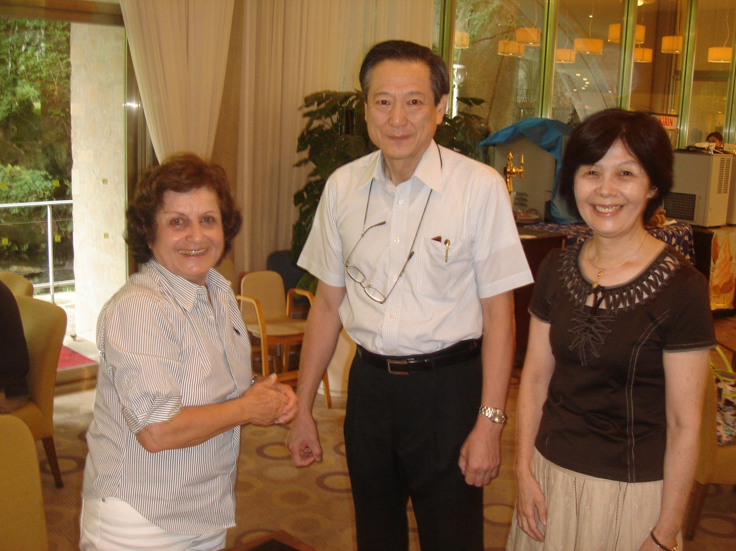
Dr./Mrs. Suzuki (Local hosts)
And Mrs. Akbarnia

Slide 8
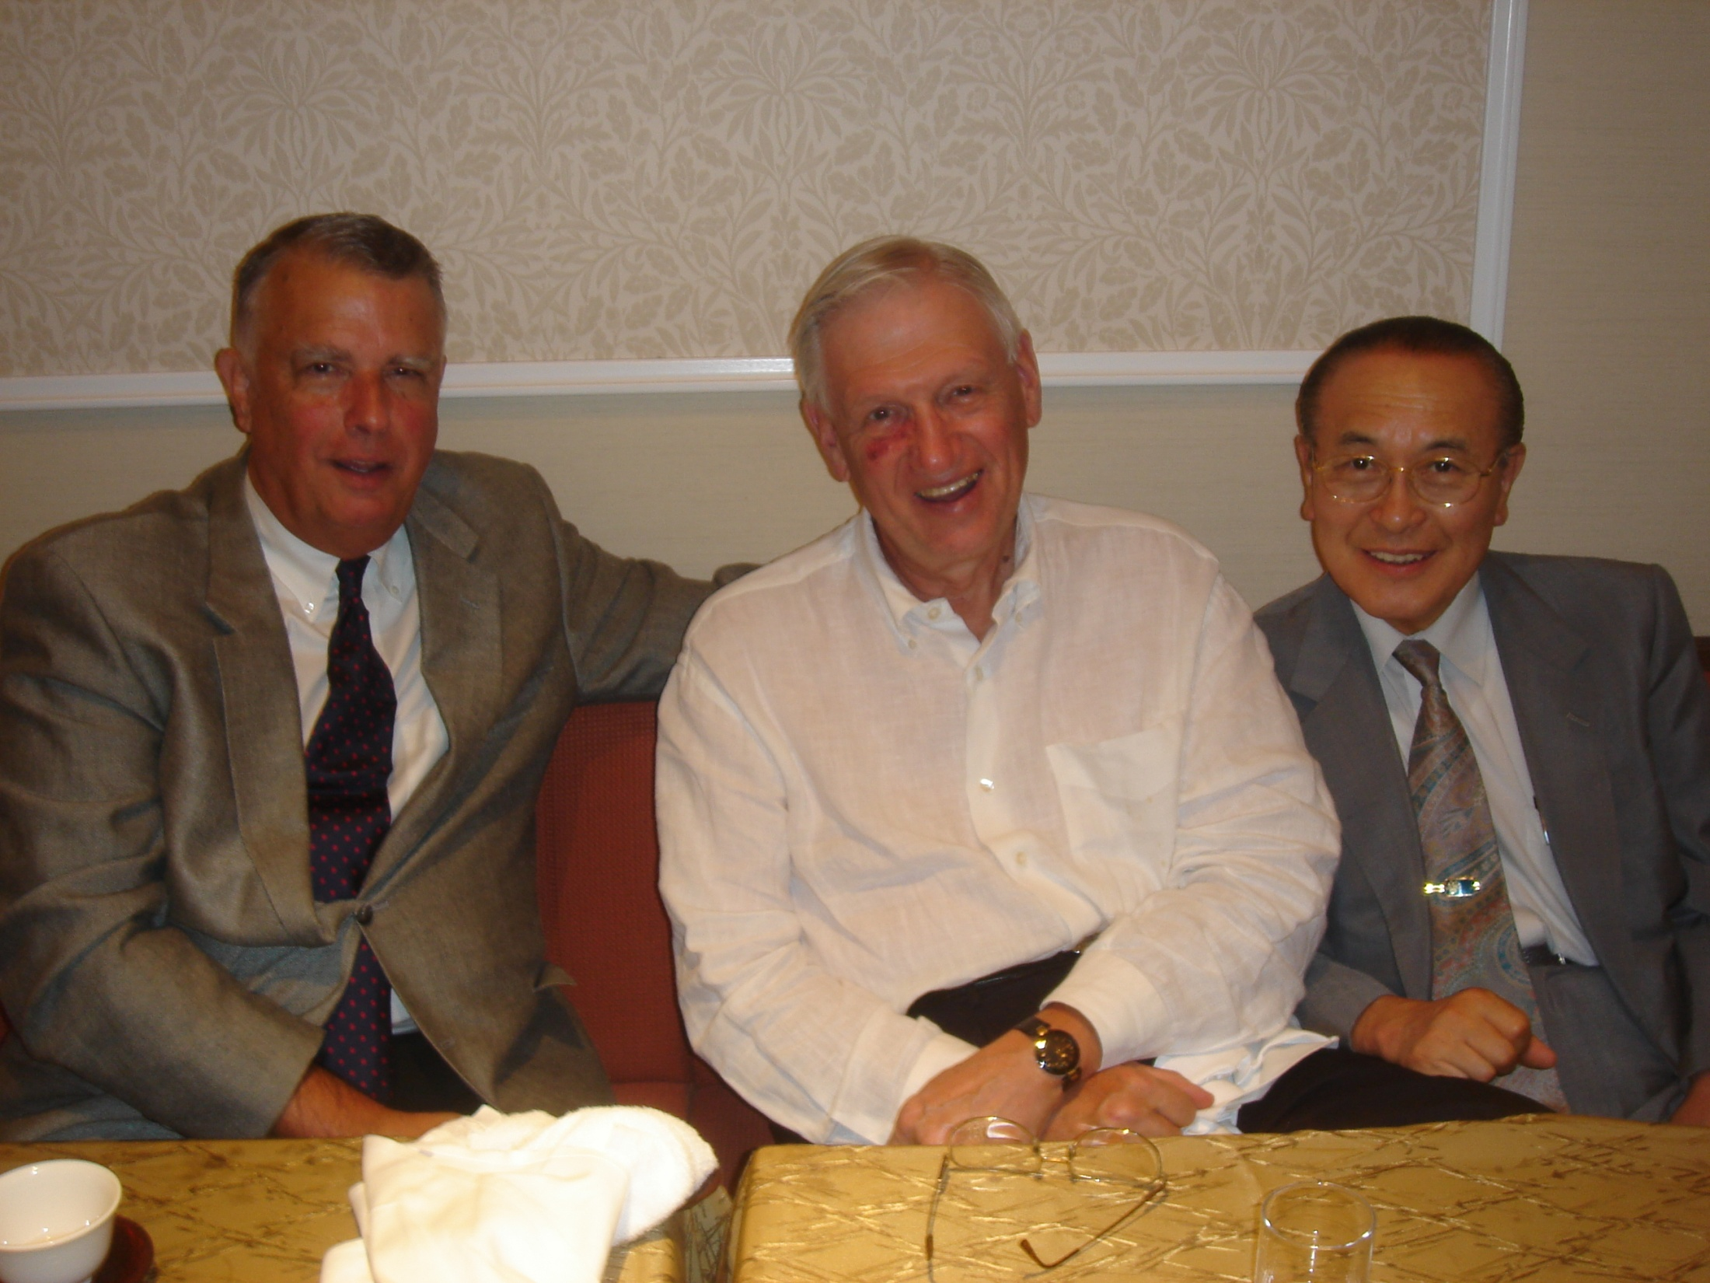

Slide 9
Professor Kiyoshi Kaneda
The Harrington Guest Lecturer

Slide 10
Prof Fuji
Japanese expert on DVT/PE
In spinal surgery patients

Slide 11
Dr. Dormans—DVT/PE in children with spine ops

Slide 12
Turkish experience
With DVT-PE prevention/Rx
In spine patients

Slide 13
Mehdian/Nottingham
Approach to HGS/PTOSIS
Reconstruction—8 patients
Mr. Jwalant Mehta
Mrs. Houseworth—death
From PE 4 days p staged corr’n of HGS
Thru a well-placed IVC filter

Slide 14
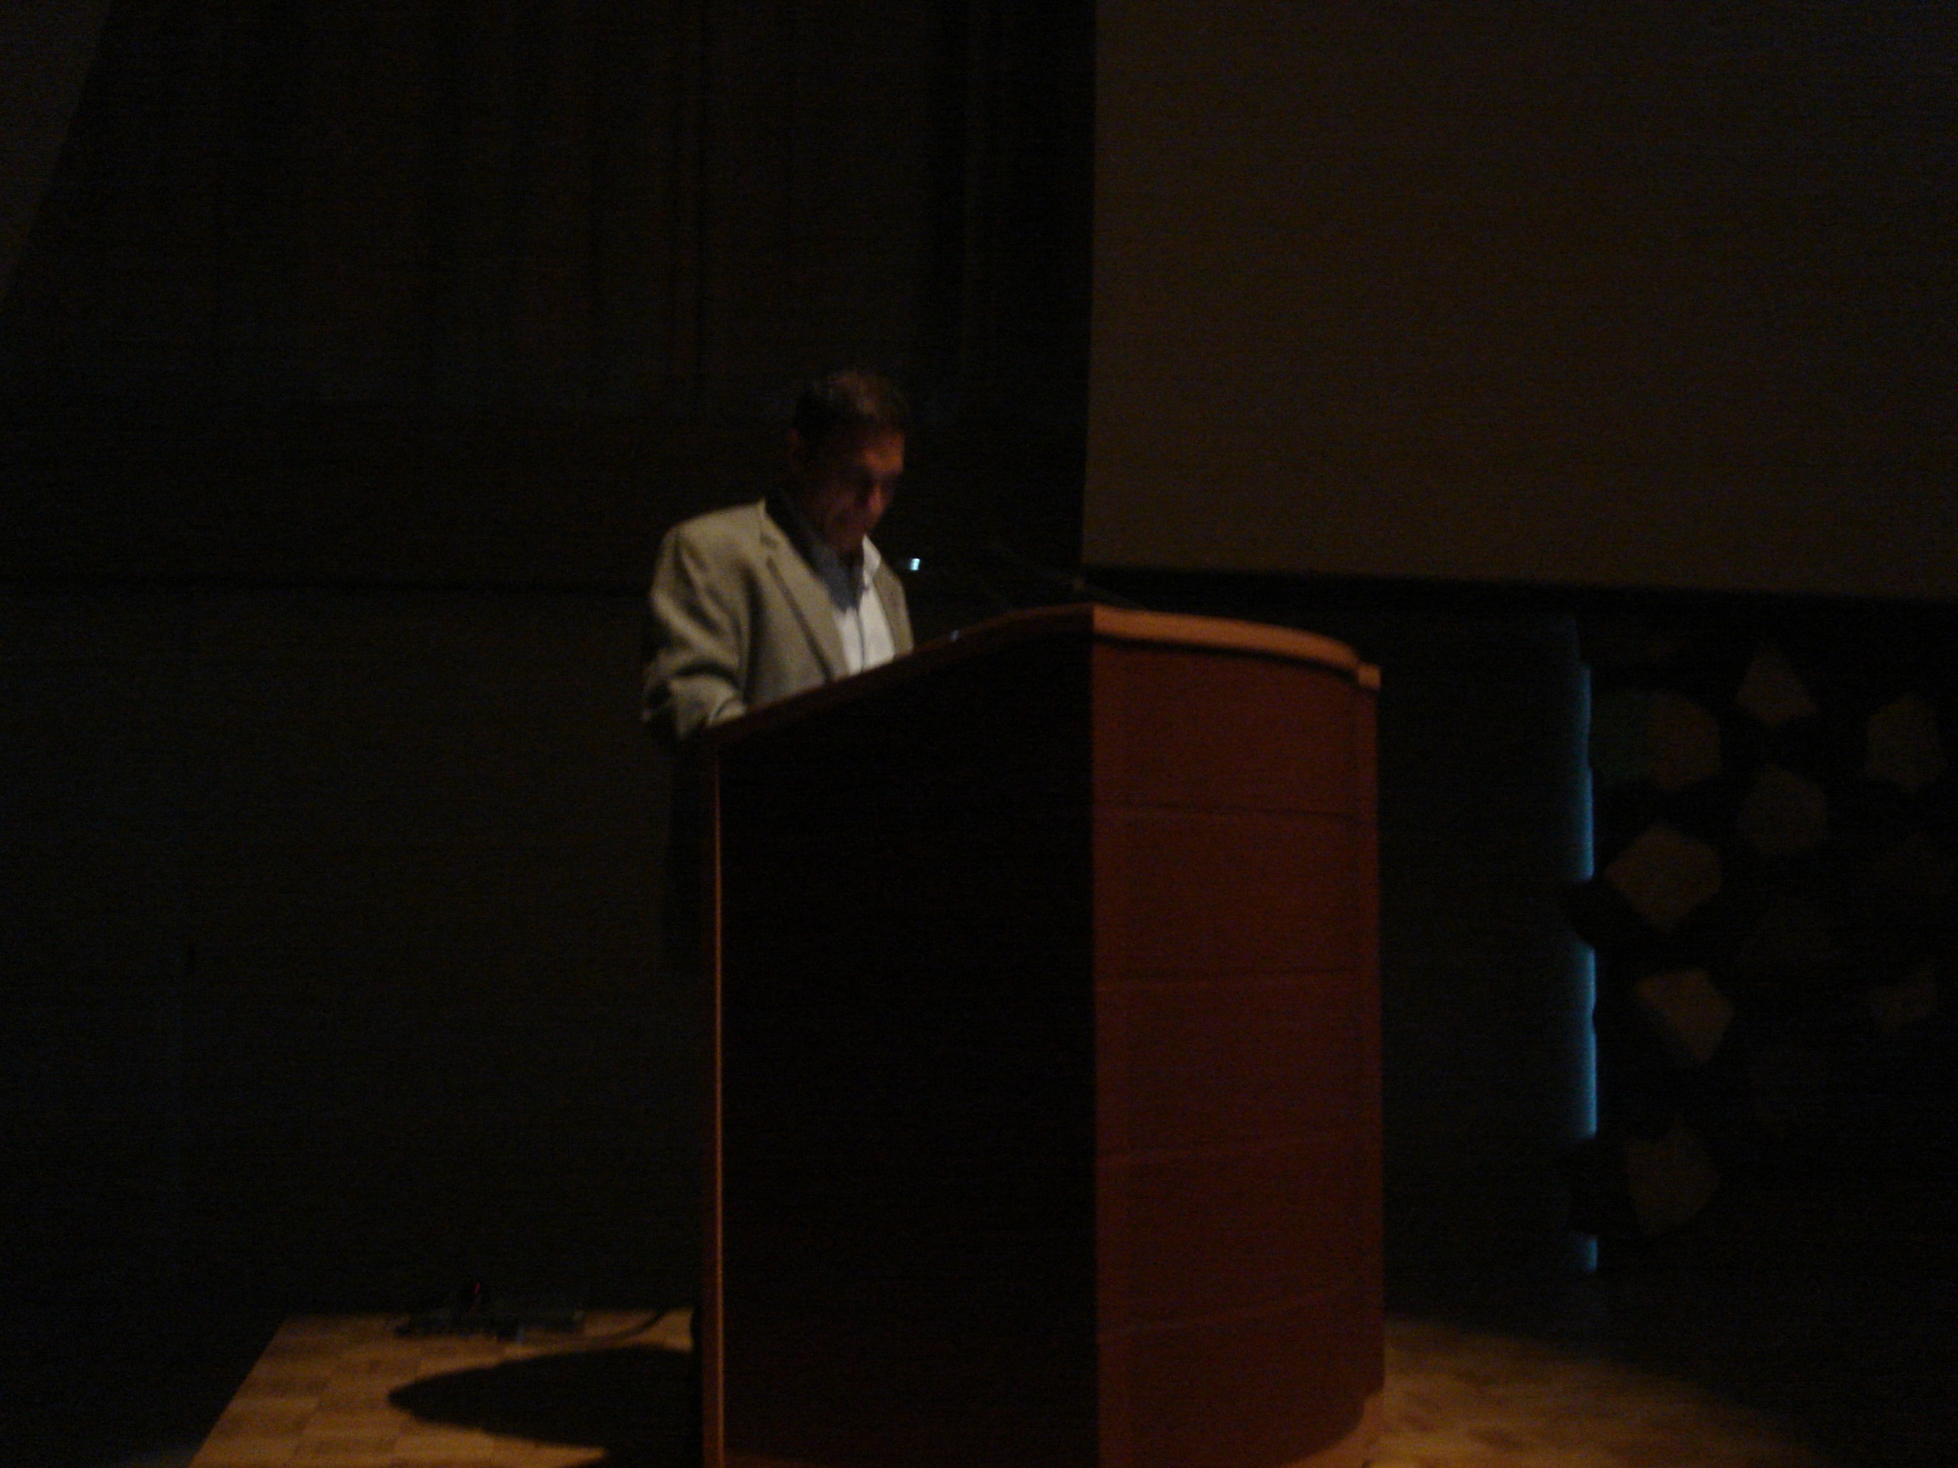
Kebaish---PSO approach for Ptosis-6 patients

Slide 15
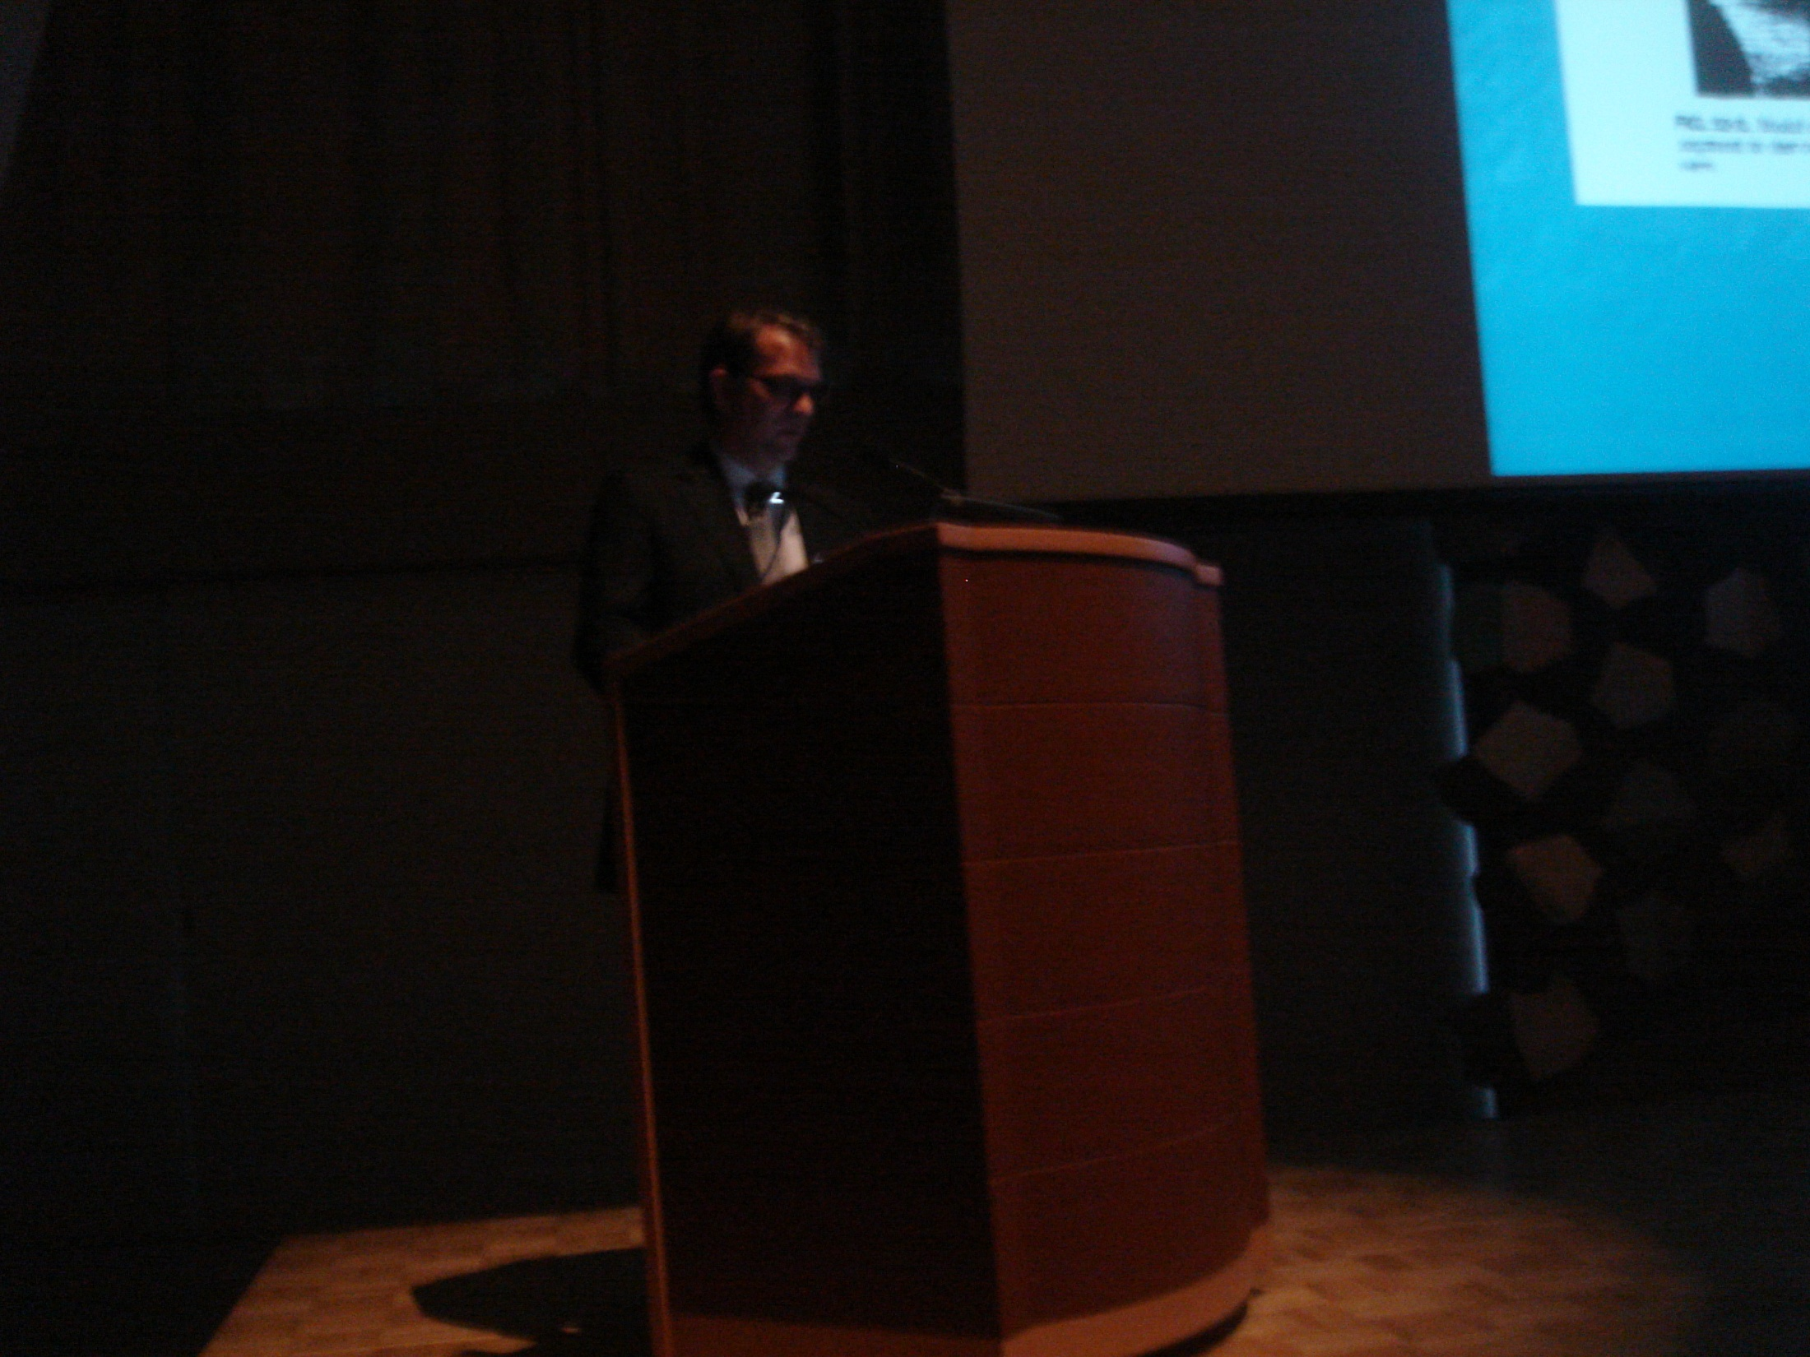
Hart---bohlman approach for HGS—13 patients

Slide 16
Matsumoto—Keio approach to HGS/ptosis

Slide 17
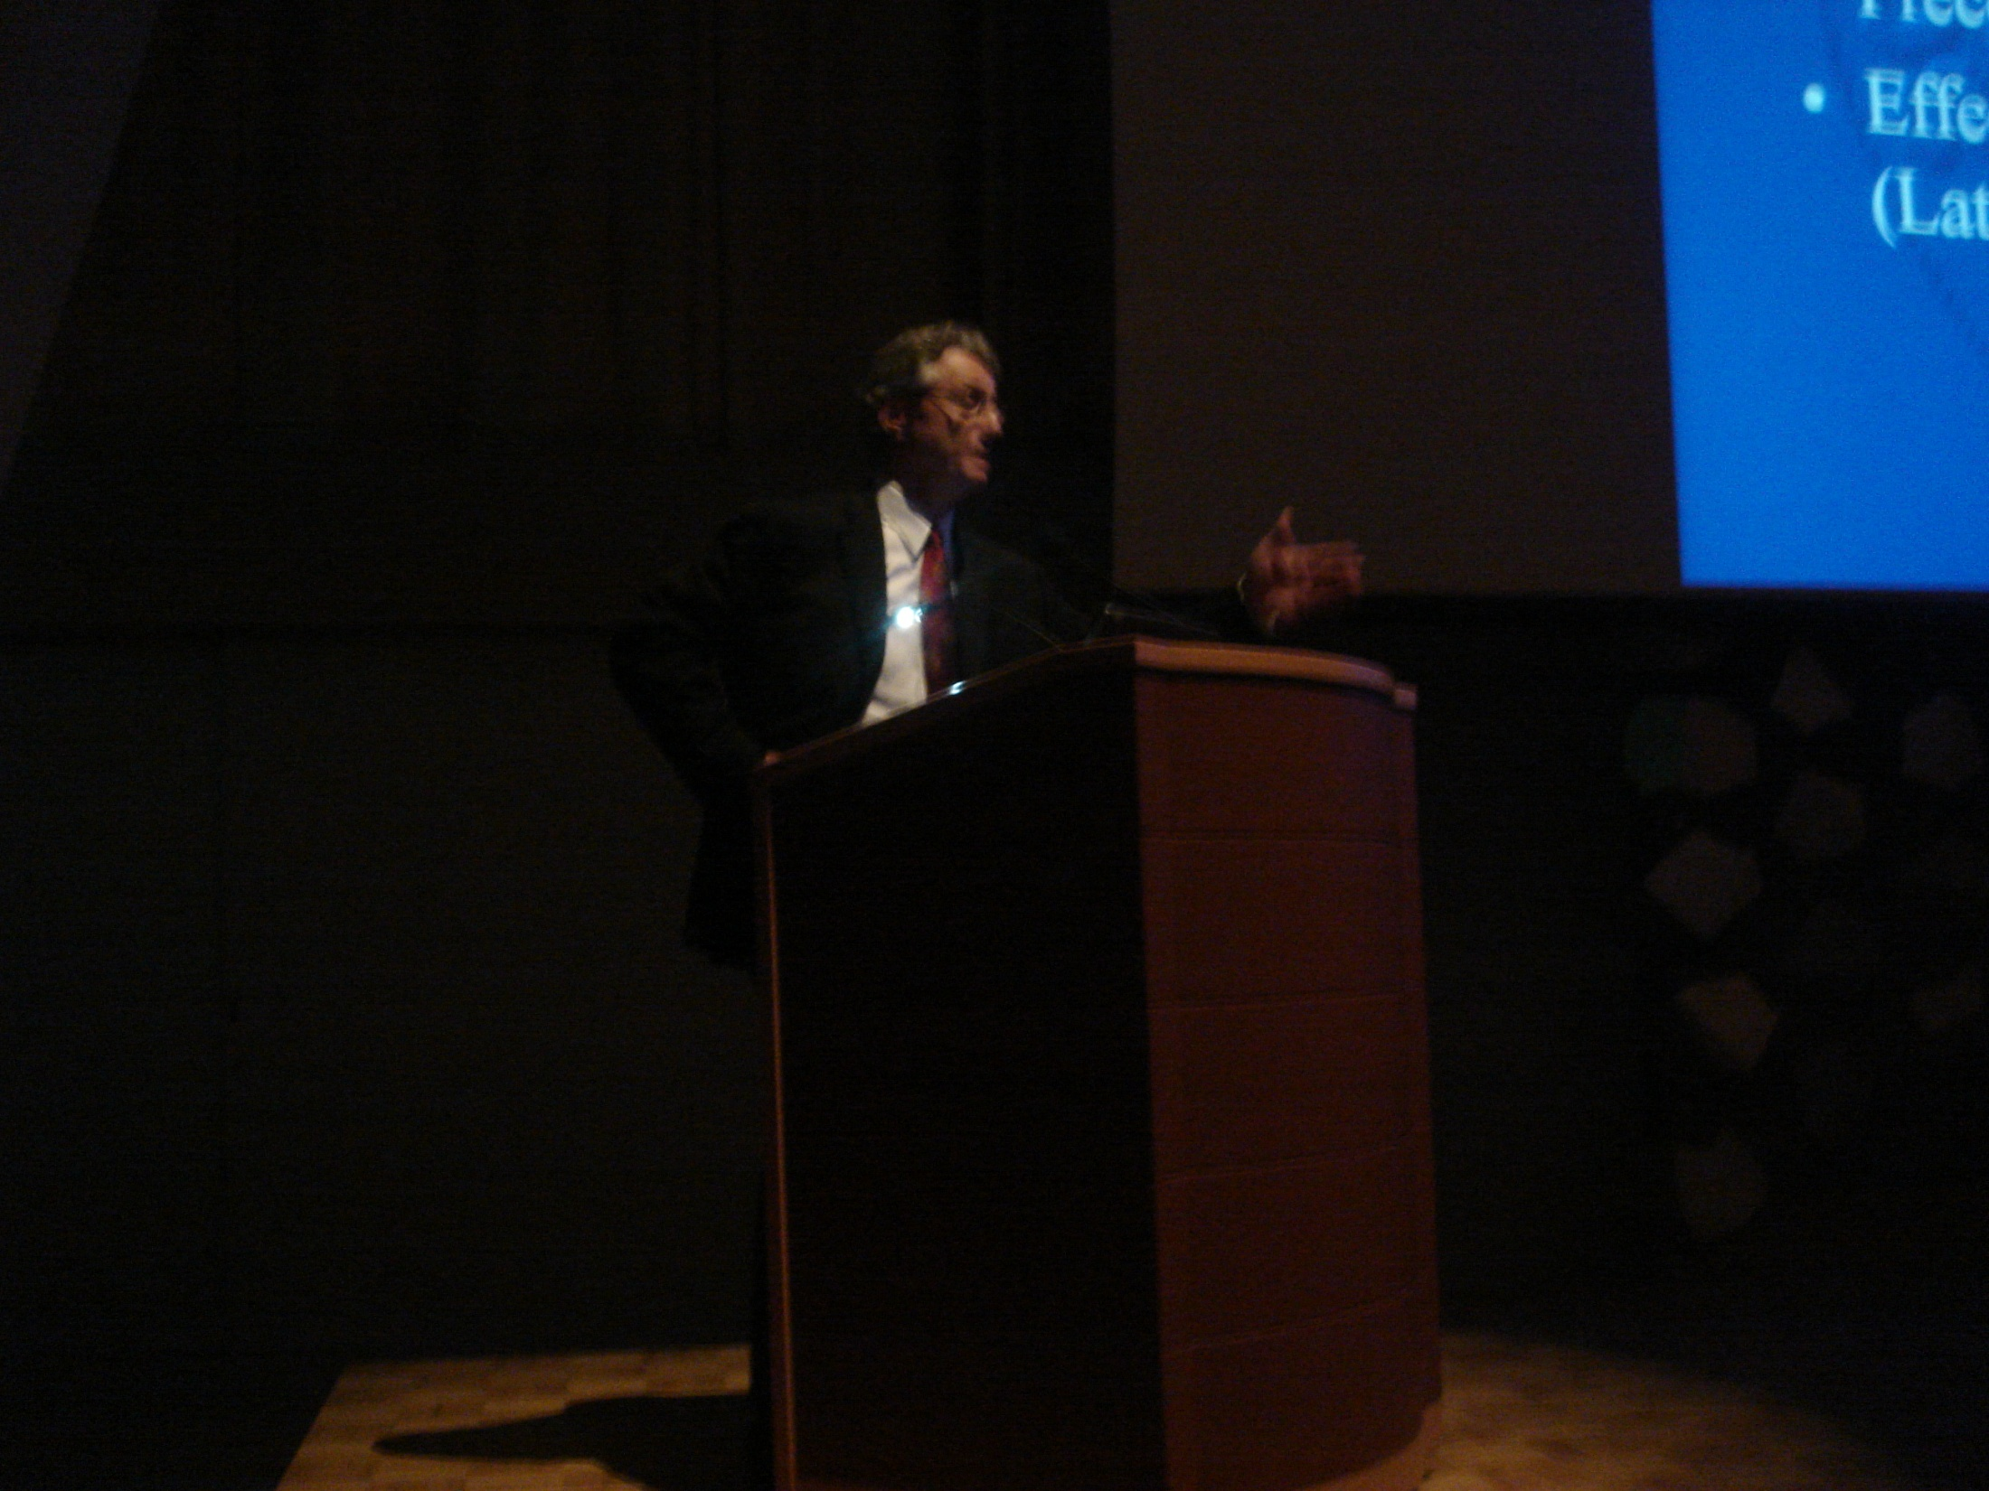
Mardjetko---lumbar transition/kyphosis p corr’n of HGS

Slide 18
Labelle---sagittal index/pelvic incidence
In the Dx and Rx of HGS and ptosis

Slide 19
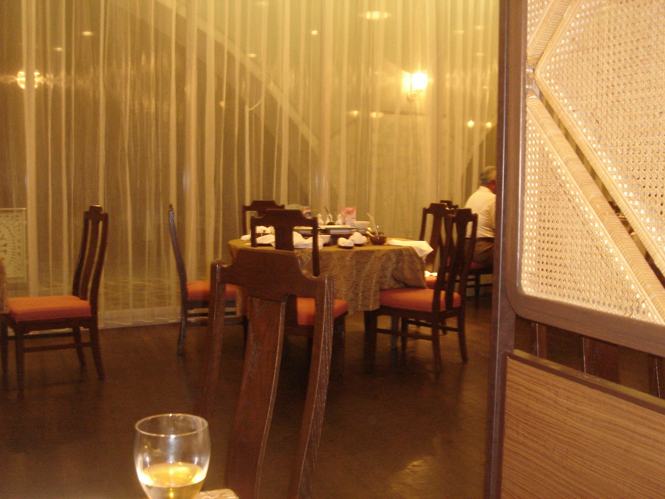

Slide 20
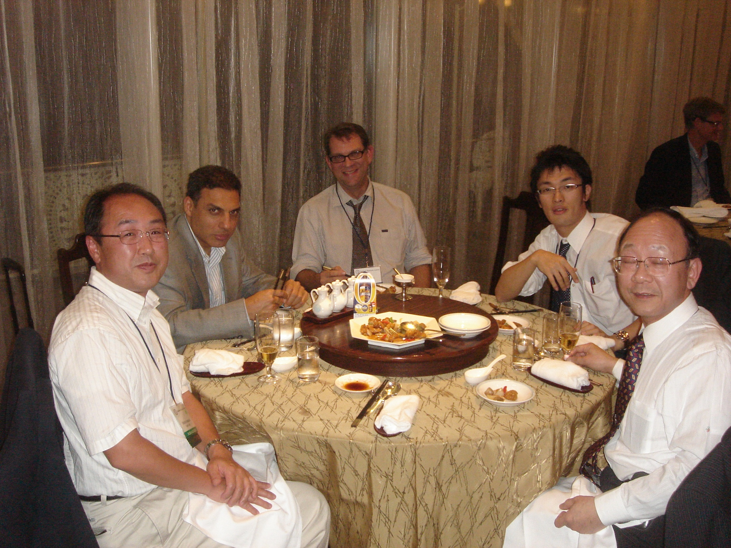

Slide 21
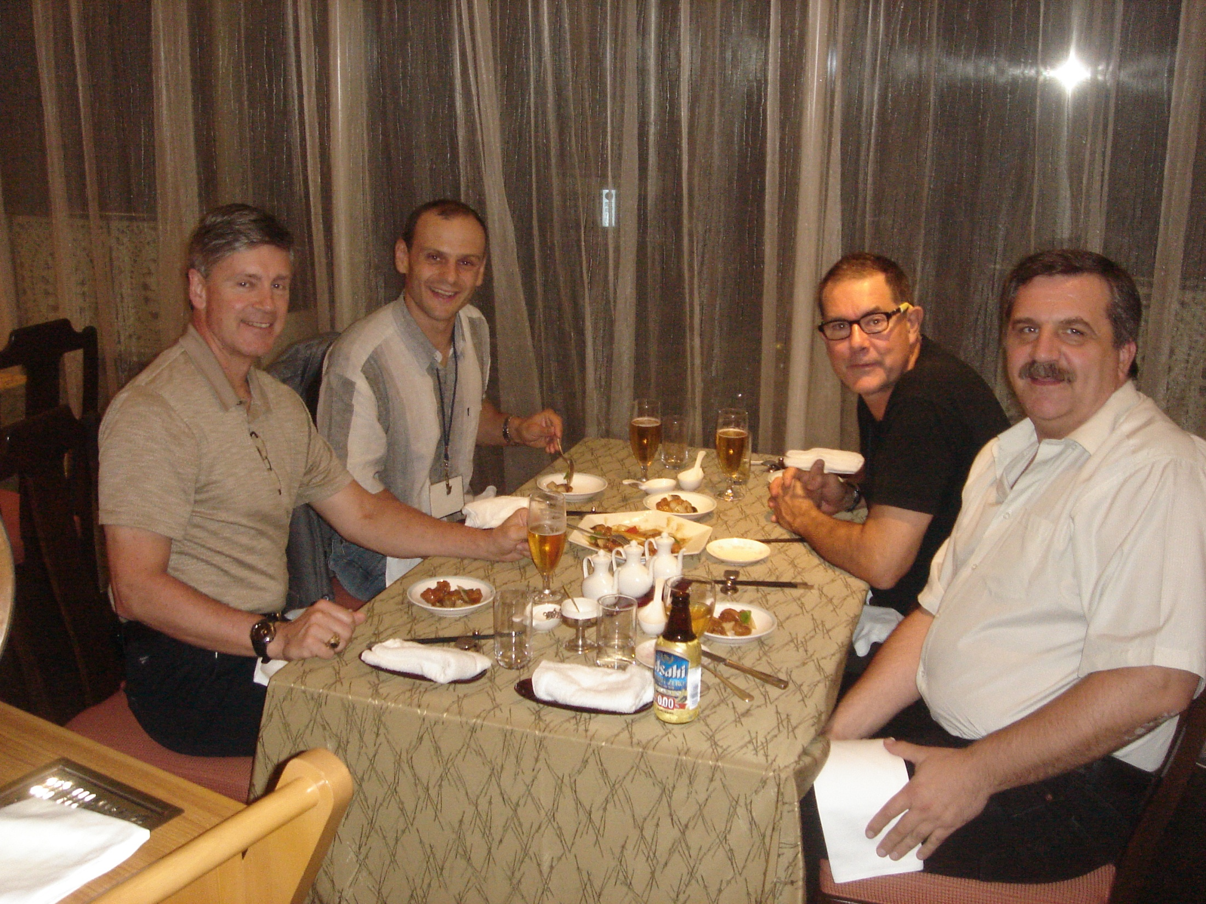

Slide 22
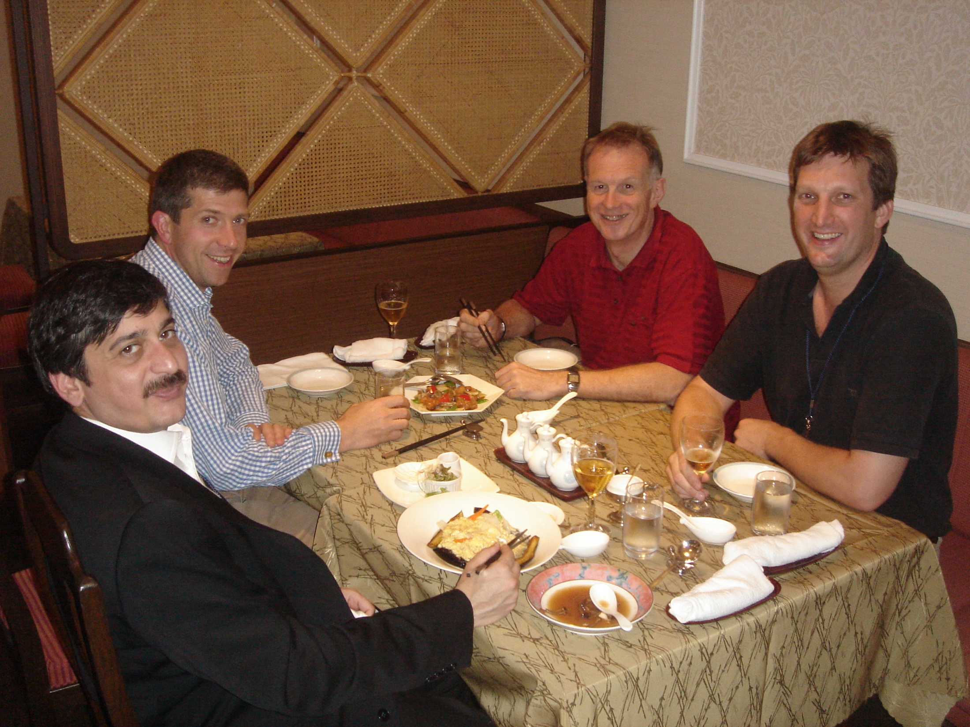

Slide 23
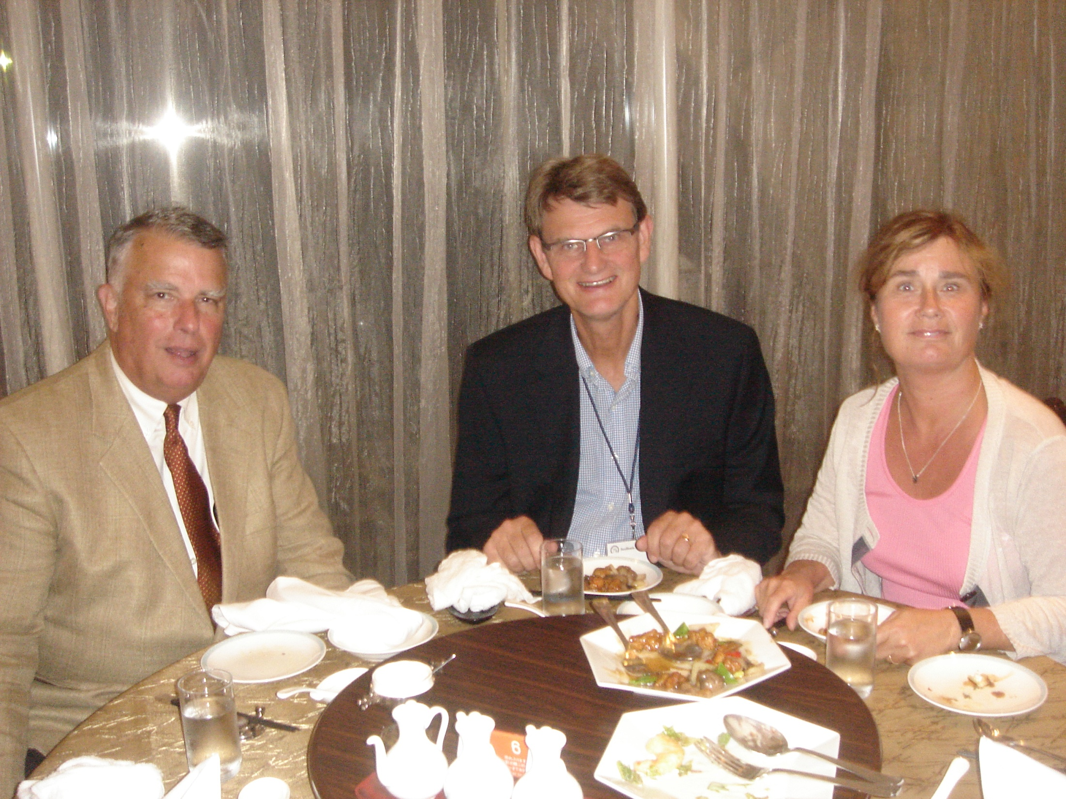
Gaines---review of Anderson’s
JBJS work
On incidence, prevention of
DVT/PE
In spine recon pts.
Review of ptosis recon by L5 vert. approach
W uniform f/u of 43 pts. Over 31 years
—single surgeon series

